Slide 1
Parallel Algorithms for array processors
Motivation for SIMD array processors was to perform parallel computations on vector or matrix type of data.
Parallel processing algorithms have been developed for SIMD computers. SIMD algorithms can be used to perform matrix Xn, FFT, matrix transposition, summation of vector elements, sorting, linear recurrence, to solve partial differential equations etc.

Slide 2
SISD matrix multiplication
Let A=[a_{ik}] and B=[b_{kj}] be n x n matrices. Product matrix C=A X B = [c_{ij}] of dimension n x n.
The elements of the product matrix C is related to elements of A and B by :
c_{ij} = ∑^{n} _{k=1} a_{ik} x b_{kj} for 1<=i <=n and 1<=j<=n.
There are n³ cumulative multiplications to be performed.

Slide 3
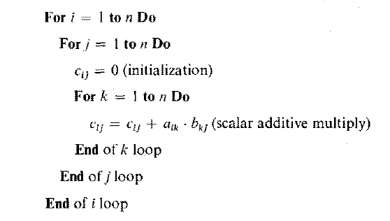
An 0(n³) algorithm for SISD matrix multiplication

Slide 4
Cumulative multiplication refers to the linked multiply-add operation c<-c + a x b.
Addition is merged into the multiplication because the multiply is equivalent to multioperand addition.
Therefore unit time is the time required to perform one cumulative multiplication.

Slide 5
In a conventional SISD uniprocessor system, the n³ cumulative multiplications are carried out by a serially coded program with 3 levels of DO loops corresponding to three indices to be used.
The time complexity of this sequential program is proportional to n³.

Slide 6
Implementation of matrix multiplication on a SIMD computer with n PEs.
The algorithm construct depends heavily on the memory allocation of the A, B and C matrices in the PEMs.
Suppose we store each row vector of the matrix across the PEMs.
SIMD
Matrix Multiplication

Slide 7
The 2 parallel do operations correspond to vector load for initialization and vector multiply for the inner loop of additive multiplications. The time complexity has been reduced to O(n²).
Therefore the SIMD algorithm is n times faster.

Slide 8
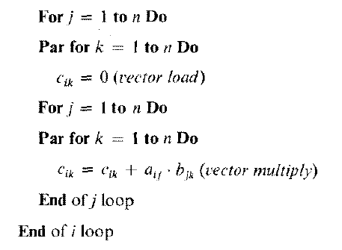
An 0(n²) algorithm for SIMD matrix multiplication

Slide 9
Memory allocation for SIMD matrix multiplication
Column vectors are stored within the same PEM. This memory allocation scheme allows parallel access of all the elements in each row vector of the matrices.

Slide 10
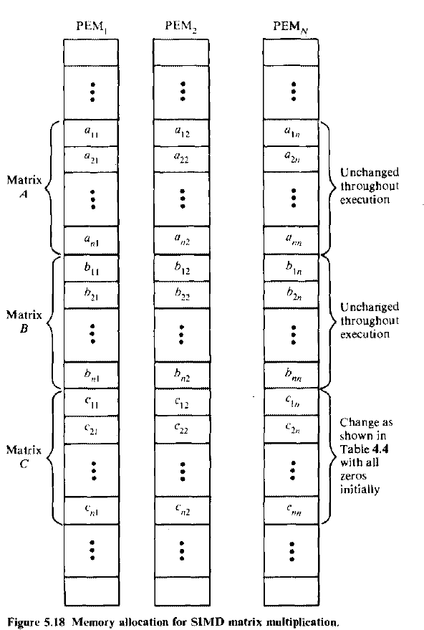

Slide 11
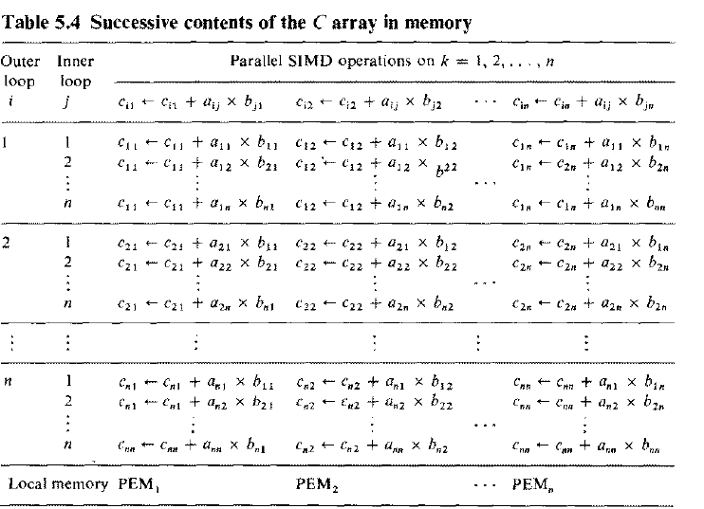

Slide 12
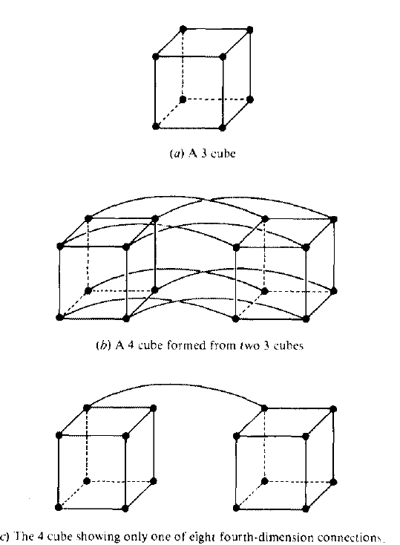
4 CUBE CONSTRUCTION FROM TWO 3 CUBE NETWORKS(nlogn)

Slide 13
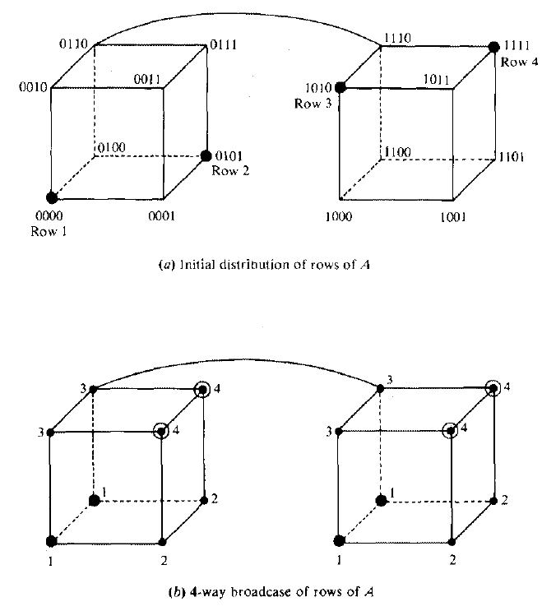

Slide 14
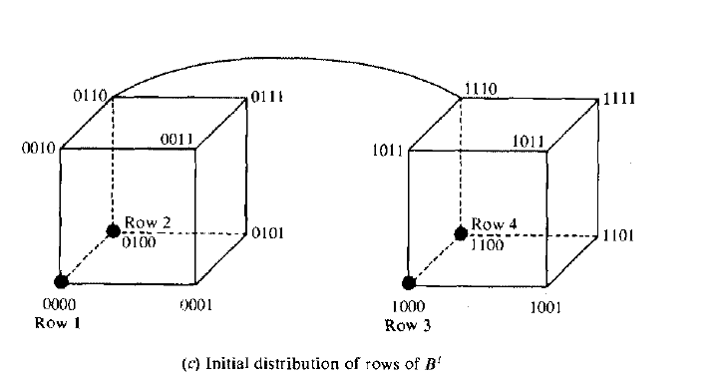

Slide 15
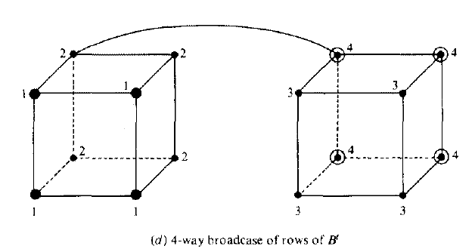

Slide 16
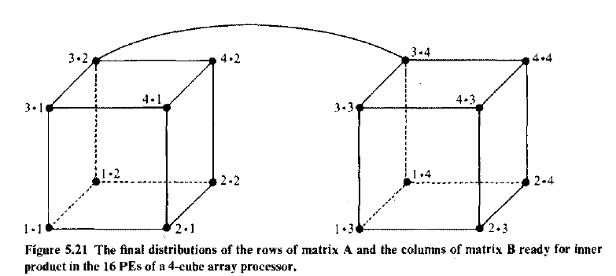

Slide 17
Parallel sorting on array processors
An SIMD algorithm is to be presented for sorting n² elements on a mesh-connected processor array in O(n) routing and comparison steps. This shows a speedup of O(log₂n) over the best sorting algorithm, which takes O(nlog₂n) steps on a uniprocessor system.

Slide 18
Assume an array processor with N=n² identical PEs interconnected by a mesh n/w similar to the Illiac-IV except that the PEs at the perimeter have 2 or 3 rather than 4 neighbours.
ie, there are no wraparound connections in this simplified mesh n/w.

Slide 19
Eliminating the wraparound condition simplifies the array sorting algorithm.
The time complexity of the array sorting algorithm would be affected by at most a factor of two if the wraparound connections were included.

Slide 20
2 time measures are needed to estimate the time complexity of the parallel sorting algorithm.
Let t_{R} be the routing time required to move one item from a PE to one of its neighbours, and tc be the comparison time required for one comparison step.

Slide 21
Concurrent data routing is allowed. Upto N comparisons may be performed simultaneously.
This means that a comparison-interchange step between two items in adjacent PEs can be done in 2t_{R} +t_{c} time units (route left, compare and route right).
A mixture of horizontal and vertical comparison interchanges requires at least 4t_{R} + t_{c} time units.

Slide 22
The sorting problem depends on the indexing schemes on the PEs.
The PEs may be indexed by a bijection from {1,2,..,n} x {1,2,..,n} to{0,1,…N-1}, where N=n².

Slide 23
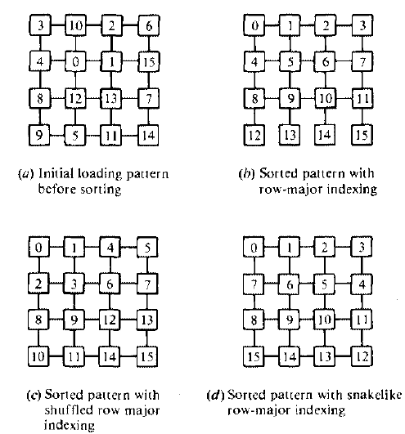
Sorting patterns with respect to three ways of indexing the PEs

Slide 24
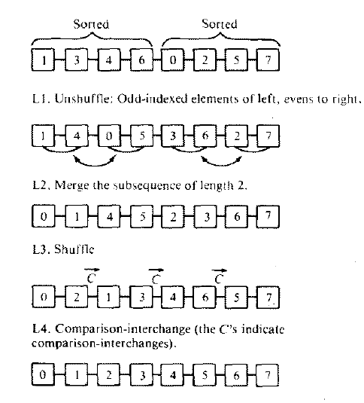

Slide 25
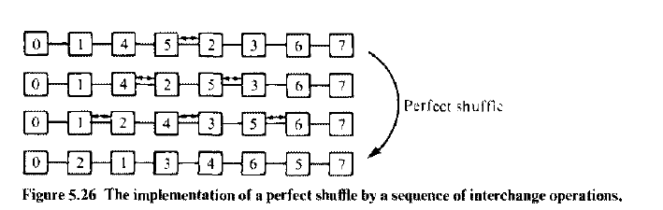

Slide 26
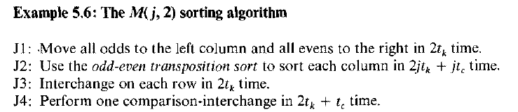

Slide 27
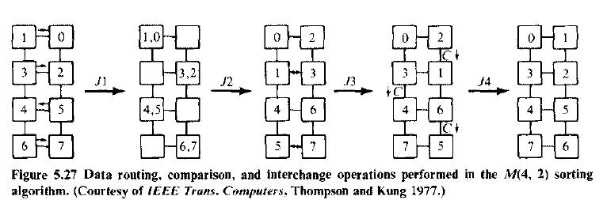

Slide 28
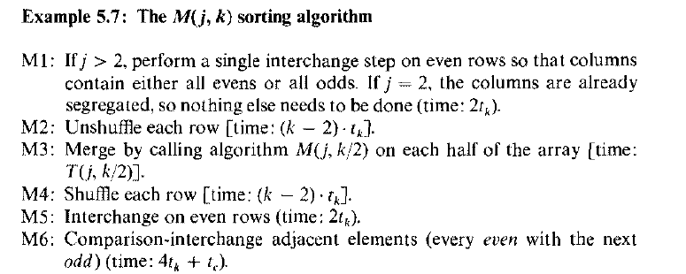

Slide 29
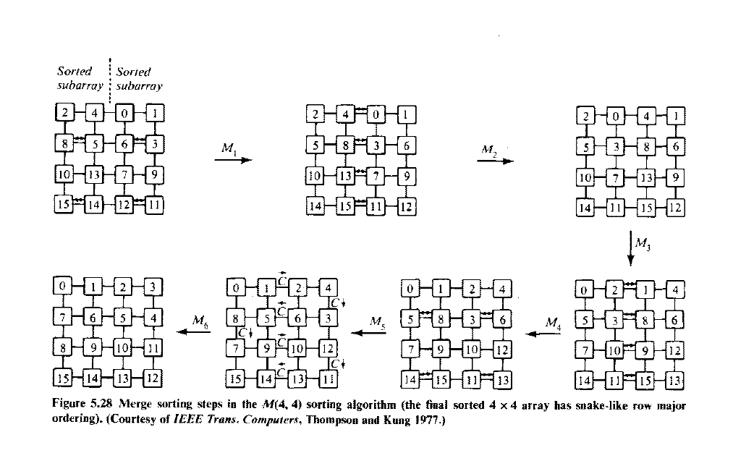

Slide 30
Associative array processing
2 SIMD computers, the Goodyear Aerospace STARAN and the Parallel Element Processing Ensemble (PEPE) have been built around an associative memory (AM) instead of using the conventional RAM.

Slide 31
Associative memory organization
Data stored in associative memory are addressed by their contents.
AMs are known as content addressable memory, parallel search memory and multi access memory.

Slide 32
Advantage of AM over RAM is its capability of performing parallel search and parallel comparison operations.
The inherent parallelism in associative memory has a great impact on the associative processors.
These are needed in applications like storage and retrieval of rapidly changing databases, radar signal tracking etc.

Slide 33
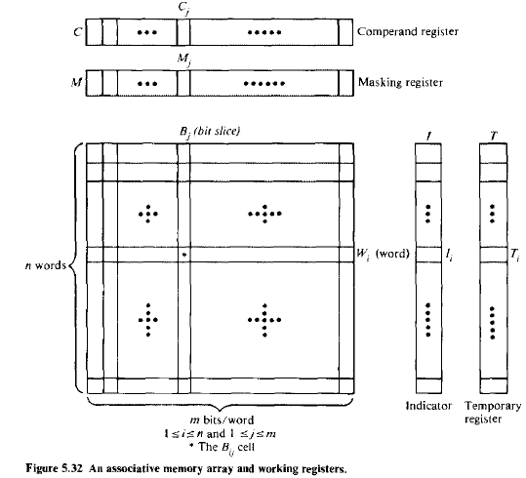
Cost of associative memory is much higher than the RAM.
Structure of basic AM

Slide 34
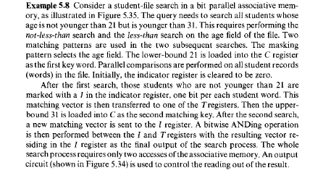

Slide 35
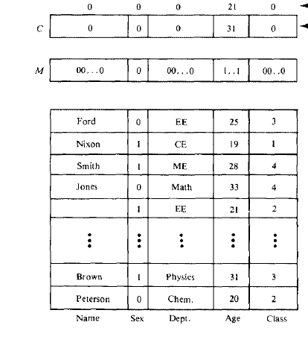

Slide 36
Associative memory array consists of n words with m bits per word. Each bit cell in the n x m array consists of a flip flop associated with some comparison logic gates for pattern match and read write control.
This logic-in-memory structure allows parallel read or parallel write in the memory array.
A bit slice is a vertical column of bit cells of all the words at the same position.

Slide 37
The j^{th} bit cell of the i^{th} word is denoted as B_{ij} for 1<=i<=n and 1<=j<=m.
The ith word is denoted as:
W_{i}= (B_{i1} B_{i2},…, B_{im}) for i=1,2,…,n
and the jth bit slice is denoted as
B_{j}=(B_{1j} B_{2j},… B_{nj}) for j=1,2,…,m.

Slide 38
Each bit cell B_{ij} can be written in, read out or compared with an external interrogating signal.
The parallel search operations involve both comparison and masking.
There are a number of registers and counters in the associative memory.

Slide 39
Comperand register C=(C₁,C₂,..C_{m}) is used to hold the key operand being searched for or being compared with.
Masking register M=(M₁, M₂,…M_{m}) is used to enable or disable the bit slices to be involved in the parallel comparison operations.

Slide 40
Indicator register I=(I₁, I₂,…I_{n}) and Temporary registers T=(T₁, T₂,…T_{n}) are used to hold the current and previous match patterns, respectively.
Each of these registers can be set, reset or loaded from an external source with any desired binary patterns.
Counters are used to keep track of the i and j index values.

Slide 41
There are also some match detection circuits and priority logic, which are peripheral to the memory array and are used to perform some vector boolean operations among the bit slices and indicator patterns.

Slide 42
The search key in the C register is first masked by the bit pattern in the M register. This masking operation selects the effective fields of bit slices to be involved.
Parallel comparisons of the masked key word with all words in the AM are performed by sending the proper interrogating signals to all bit slices involved.
All involved bit slices are compared in parallel or in a sequential order, depending on the AM organization.

Slide 43
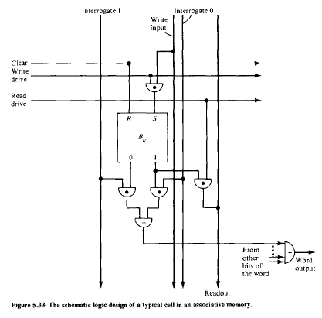
The interrogation mechanism, read and write drives, and matching logic within a typical bit cell.
Schematic logic design of a typical cell in an AM

Slide 44
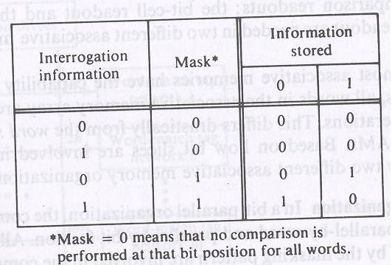

Slide 45
Interrogating signal are associated with each bit slice, and the read write drives are associated with each word.
There are 2 types of comparison readouts: the bit-cell readout and the word readout.
2 types of readout are needed in 2 different AM organizations.

Slide 46
2 different associative memory organization
Bit parallel organization: In bit parallel organization the comparison process is performed in a parallel-by-word and parallel-by-bit fashion.
Bit slices which are not masked off by the masking pattern are involved in the comparison process.

Slide 47
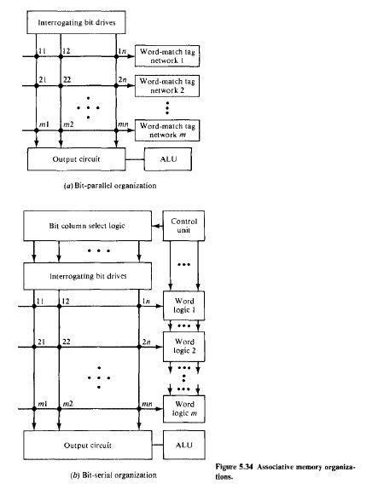
Bit-serial organization: This memory organization operates with one bit slice at a time across all the words.

Slide 49
The particular bit slice is selected by an extra logic and control unit.
The bit cell readouts will be used in subsequent bit slice operations. STARAN has the bit serial memory organization and PEPE with the bit parallel organization.

Slide 50
Associative processors (PEPE and STARAN)
Associative processor is a SIMD machine with the capabilities:
stored data items are content addressable
arithmetic and logic operations are performed over many sets of arguments in a single instruction.

Slide 51
Because of the content addressable and parallel processing capabilities, associative processors form a special subclass of SIMD computers.
Classification of Associative processors into 2 classes:
fully parallel versus the bit serial organizations depending on AM used.

Slide 52
The PEPE architecture:
There are 2 types of fully parallel associative processors: word- organized and distributed logic.
Word organized associative processor:
Comparison logic is associated with each bit cell of every word and the logical decision is available at the o/p of every word.

Slide 53
Distributed logic associative processor:
Comparison logic is associated with each character cell of a fixed no. of bits or with a group of character cells.
PEPE is based on this.
--less complex
--less expensive
Schematic block diagram of PEPE

Slide 54
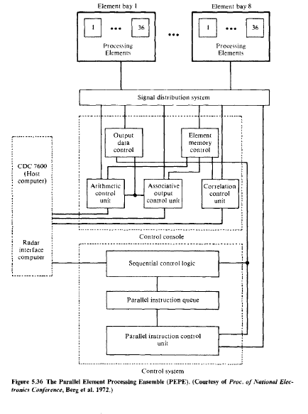

Slide 55
---is attached to general purpose machine CDC7600
-- a special purpose computer
--commercial model not available.
--performs real-time radar tracking in the antiballistic missile (ABM) environment.

Slide 56
PEPE is composed of the following functional subsystems: an o/p data control, an element memory control, an arithmetic control unit, a correlation control unit, an associative o/p control unit, a control system, and a no. of PEs.
Each PE consists of an arithmetic unit, a correlation unit, an associative o/p unit, and a 1024 x 32 bit element memory.

Slide 57
There are 288 PEs organized in 8 element bays.
Selected portions of the work load are loaded from a host computer to the PEs.
Each PE is delegated the responsibility of an object under observation by the radar system, and maintains a data file for specific objects within its memory and uses its associative arithmetic capability to continually update its respective file.

Slide 58
The bit-serial STARAN organization
Full parallel structure requires expensive logic in each memory cell and complicated communications among the cells.
Bit serial associative processor is less expensive than the fully parallel structure because only one bit slice is involved in the parallel comparison at a time.

Slide 59
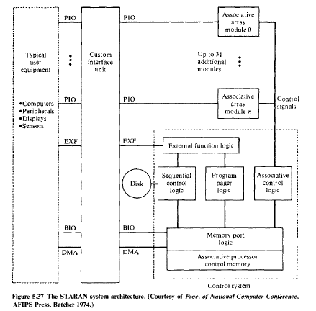
Bit serial associative processing is realized in the computer STARAN

Slide 60
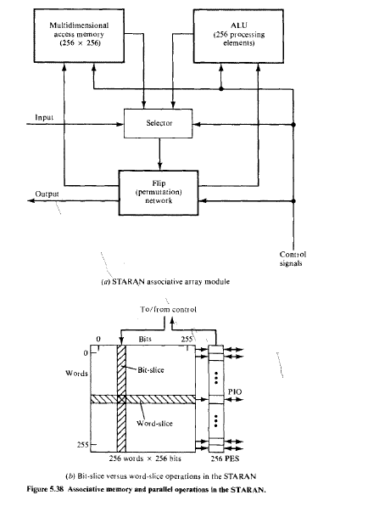

Slide 61
-- I STARAN for digital image processing (1975)
--Interface unit involves interface with sensors, conventional computers, signal processors, interactive displays and mass storage devices.
---A variety of I/O option are implemented in the custom-interface unit including the DMA, buffered I/O channels, external function channels and parallel I/O.

Slide 62
--consists of 32 associative array modules
--each associative array module contains a 256 word 256 bit multidimensional access (MDA) memory, 256 PEs, a flip n/w, a selector.
--the 256 i/p and 256 o/p (used to increase the speed of inter array data communication that allow STARAN to communicate with high bandwidth I/O device) of each associative array module are into the custom interface unit.
-- each PE operates serially bit by bit on the data in all MDA memory words.

Slide 63
Using the flip n/w, the data stored in the MDA can be accessed through the I/O channels in bit slices, word slices, or a combination of the 2.
The flip n/w is used for data shifting or manipulation to enable parallel search, arithmetic or logic operations among words of the MDA memory.

